Slide 1
Hello Elixir!
Sameeri Marryboyina

Slide 2




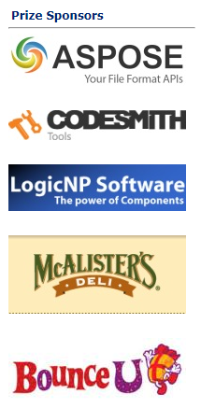


Thank you sponsors

Slide 3


Thank you TECHLAHOMA!
OKC Elixir
OKC FP
Find Techlahoma on all things social.

Slide 4

Talk Agenda
About Me
Target Audience
Foundations
The road to Elixir (How I met Elixir!)
Elixir

Slide 5
ABOUT ME

Slide 6
Hello, sameeri.
Sameeri Pavan Kumar Marryboyina
Hyderabad, India
I can communicate in Telugu, Hindi, English, German(very little)
MS in Computer Science, The University of Oklahoma
Senior Software Engineer, Telogical Systems LLC
Full Stack JS - React, Redux and its Ecosystem, Node, Express
Norman, OK

Slide 7
India
Let us travel to Sameeri’s home..
https://www.google.com/maps/place/India/@18.2937219,71.4458457,5z/data=!4m5!3m4!1s0x30635ff06b92b791:0xd78c4fa1854213a6!8m2!3d20.593684!4d78.96288

Slide 8
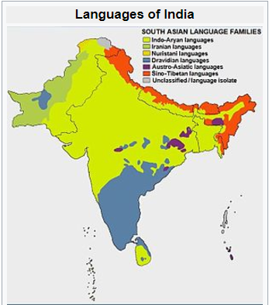
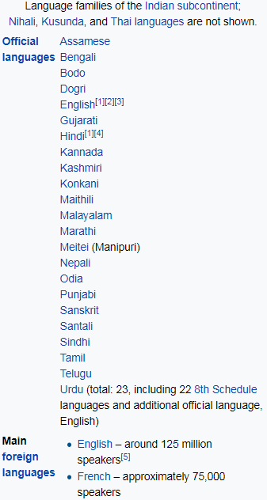
source : https://en.wikipedia.org/wiki/Languages_of_India

Slide 9
TARGET AUDIENCE

Slide 10
FOUNDATIONS

Slide 11
Being a polyglot...
WORK | SCHOOL | LEARNING | RADAR
JavaScript | C | Elixir | Elm
C# | C++/VC++ | Erlang | TypeScript
Ruby | COBOL |  | Python
Java | Assembly |  | Scala
 |  |  | Rust
 |  |  | Go

Slide 12

But, What does it mean to be a Language?

Slide 13
What kind of a problem are we trying to solve?
A language is a tool.
Problems and Contexts
We want to use the right tool for a given problem
Communication

Slide 14
A Language…
Alphabet
Constructs
Syntax
Semantics
Type System (Static vs Dynamic)
Translation Model (Compiled vs Interpreted)
Execution model
Runtime Mechanics
Specification
Implementation

Slide 15
Language tools
Editor
Compiler
REPL
Virtual Machine
Debugger
Standard Library
Dependency Management
Build tool
Workflow tools based on processes – Tests, Coverage, Syntax highlighting, Refactoring…

Slide 16
Inside the head of a software engineer
Language Syntax
Types
Philosophy
Paradigms
Standards/Best Practices
Principles
Patterns
Problem + Context
Crafting solutions

Slide 17
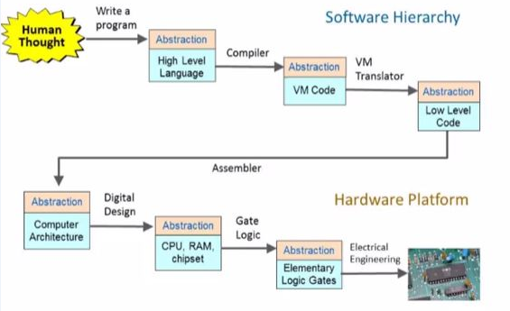
The process – From Human thought to something magical
source : http://www.nand2tetris.org/

Slide 18
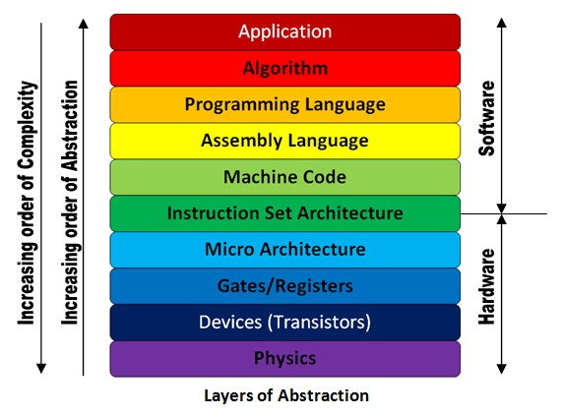
The Machine stack – Layers of Abstraction
source : http://theembeddedguy.com/2016/05/15/layers-of-abstraction/

Slide 19
Language translation
TRANSLATOR
SOURCE
LANGUAGE
TARGET LANGUAGE
Based on the language, its philosophy, the translator could be called anything. Say, compiler for instance.
A very important observation to make in the context of language translation is whether we can observe the
Generation of an intermediary file or not. This also defines the execution/runtime mechanics.

Slide 20
Modern languages
Roughly after 1985.
Memory should be managed automatically. aka Garbage Collection
Provision of higher level abstraction constructs.
The concept of a runtime, intermediary language => Virtual Machine
Developers Psychology - Discovery of patterns and anti patterns, How to write good/clean code?

Slide 21
VIRTUAL MACHINES
Source
Portability
The notion of Intermediary Language
Multiple Languages targeting the VM.
Defines execution semantics
Intermediary
Translation process
VIRTUAL MACHINE

Slide 22
Familiar virtual machines
Java World : Java Virtual Machine (JVM)
.NET World: Common Language Runtime (CLR)

Slide 23
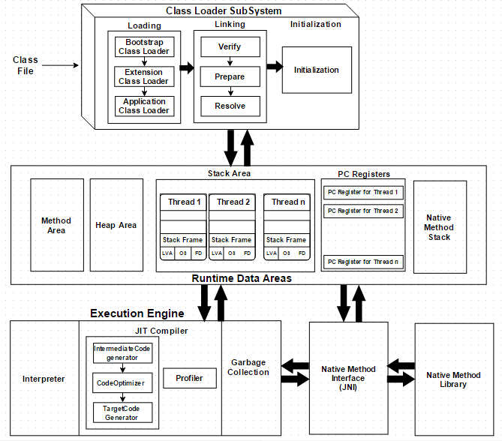
JVM

Slide 24
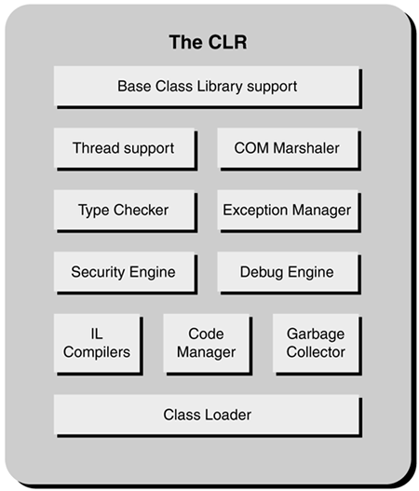
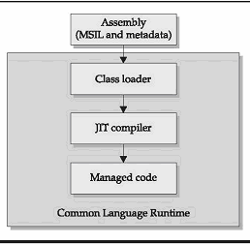
CLR

Slide 25
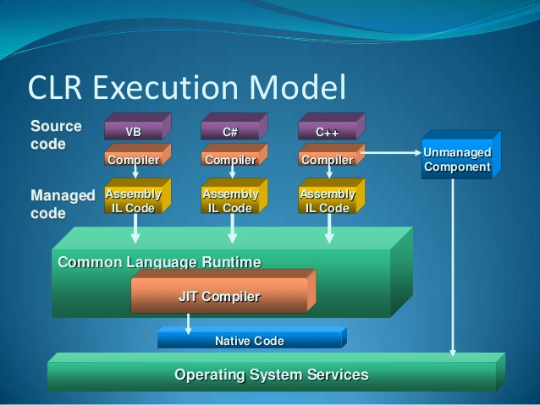
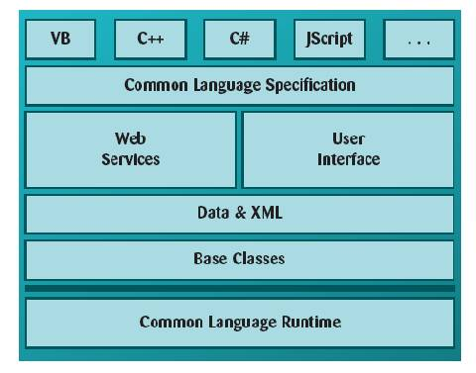
The power of an intermediary language & VM
Multiple languages can now target the intermediary language. They can also all use the
Services that the runtime has to offer. A high degree of reusability.

Slide 26
Where does the OS FIT IN?
VM/Runtime is all good.
But…
The fundamental way to run a program is via the OS.
All hail the OS!!

Slide 27
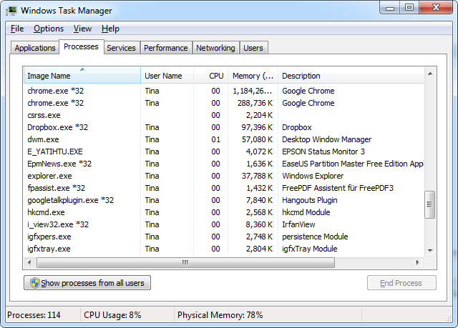
Operating system constructs
Process
Thread
Concurrency
Context Switching
Schedulers
Scheduling Algorithms
The user is tricked. But that is good.
Everyone loves Magic!

Slide 28
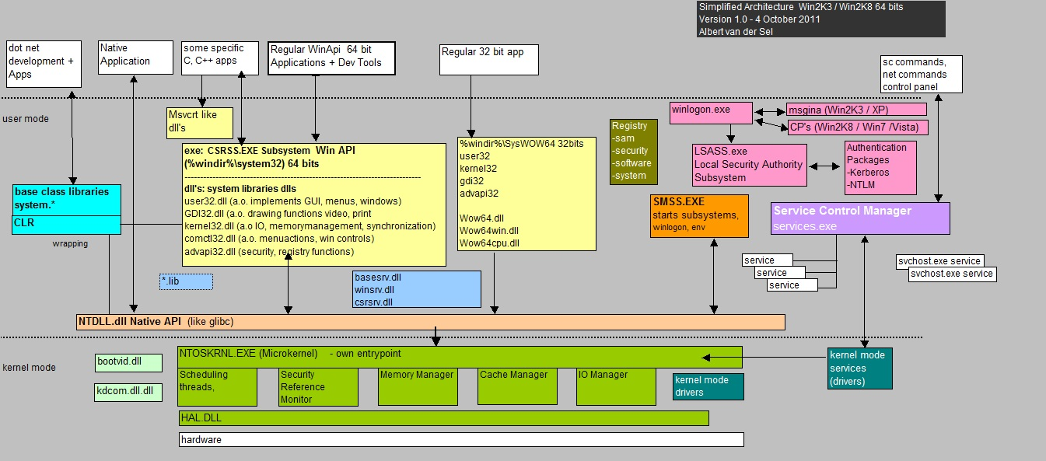
Operating system OPERATION

Slide 29
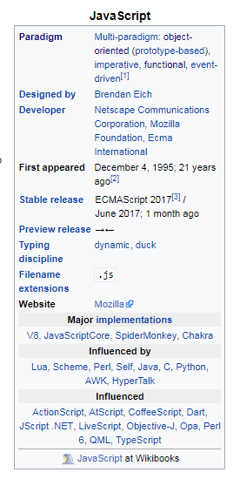
How languages s each other
Languages influence one another.
That means language designers(people) are constantly trying to improve the language
They do this by exploring other languages/environments trying to find good ideas and bring them aboard.

Slide 30
Thoughts on languages
I consider language as a tool, method to communicate our thoughts.
Since it is a tool, it is a matter of preference.
But, People are highly opinionated.
People are programmed to think in one way, when they are in one environment.
If we step out, we will find commonalities and find love for the language.
Studying a lot of languages help us grow and think better.
Languages are mostly multi-paradigm. That means we have a lot of thinking hats to put on and find the best way to solve a problem.
We should continuously discover and enjoy
Tooling is very important to build products quickly.
Tooling has a “happy developer factor” associated with it.
We should invest time in learning and learning is continuous.
We should try to craft clean code.

Slide 31

The road to elixir…

Slide 32
Core LEARNING interests
Distributed Systems
Event Oriented Architecture
Message Oriented sytems
Highly scalable systems
Reactive Architectures
“All the vocabulary is great! How should we learn these? What’s the plan?” I said to myself.

Slide 33
The bus
Service Bus
Enterprise Service Bus
Message Bus
I encountered a lot of terms.
I worked on NServiceBus in my .NET days!

Slide 34
What does it mean to be a distributed system?
The 8 Fallacies of Distributed Computing
https://en.wikipedia.org/wiki/Fallacies_of_distributed_computing
Networks
Interprocess communication
Communication, Collaboration, Coordination.
Application integration

Slide 35
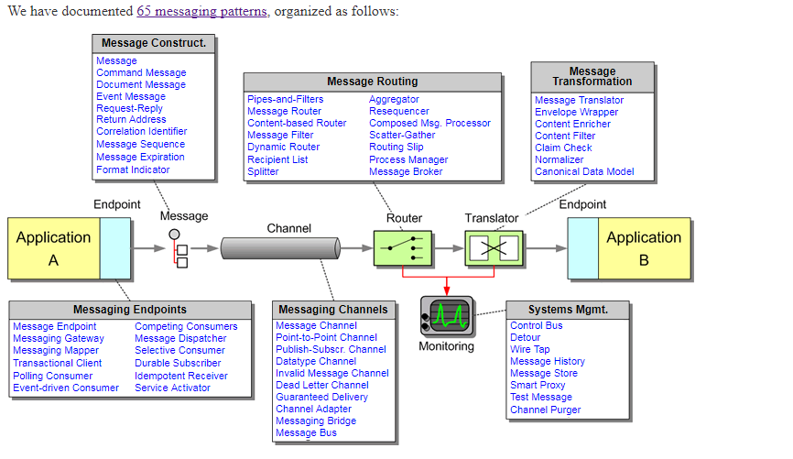
Integration patterns
http://www.enterpriseintegrationpatterns.com/patterns/messaging/

Slide 36
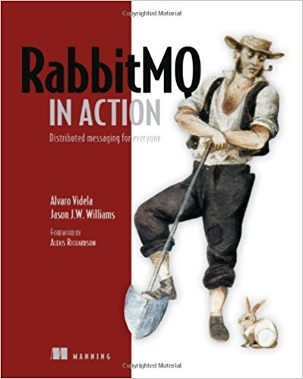
RABBITMQ ADVENTURES
AMQP
RabbitMQ history
RabbitMQ Constructs
RabbitMQ examples/patterns
https://www.rabbitmq.com/getstarted.html

Slide 37
ERLANG

Slide 38
The history of Erlang
Ericsson
Problem context
The CS lab/team
Solution Approach - RESEARCH -“Investigate the right programming language/environment for the given problem.”
1982-85: “Experiments with programming of telecom using > 20 different languages. Conclusion: The language must be a very high level symbolic language in order to achieve productivity gains ! (Leaves us with: Lisp , Prolog , Parlog ...)”
1985-86: “Experiments with Lisp,Prolog, Parlog etc. Conclusion: The language must contain primitives for concurrency and error recovery, and the execution model must not have back-tracking. (Rules out Lisp and Prolog.) It must also have a granularity of concurrency such that one asyncronous telephony process is represented by one process in the language. (Rules out Parlog.)”
Conclusion: “We must therefore develop our own language with the desirable features of Lisp, Prolog and Parlog, but with concurrency and error recovery built into the language.”
Source: https://www.erlang.org/course/history

Slide 39
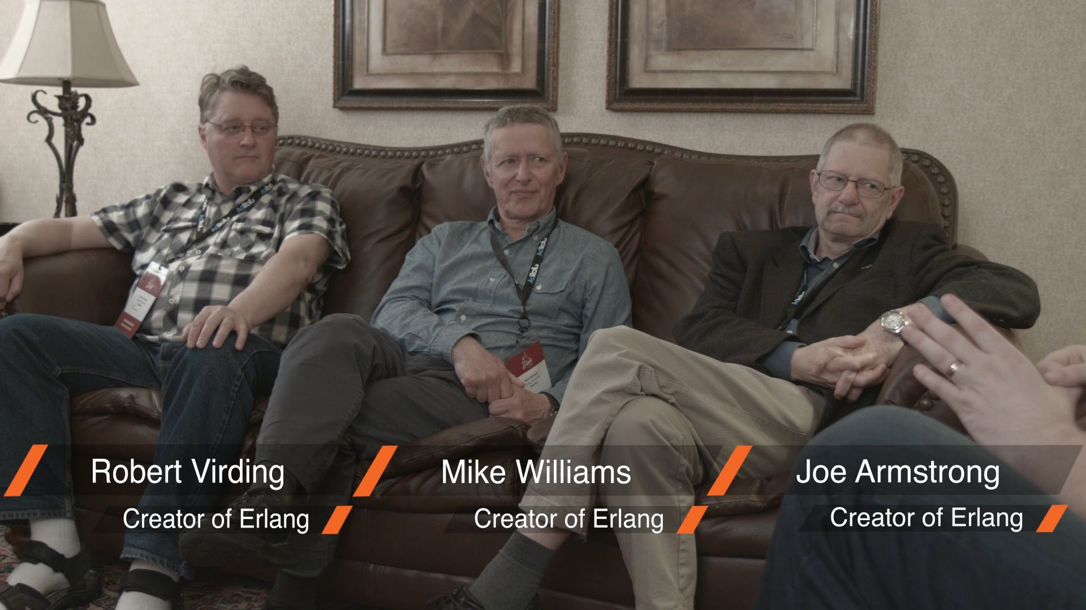
Lets meet the people
“Develop our own language with the desirable features of Lisp, Prolog and Parlog,
but with concurrency and error recovery built into the language.”

Slide 40
Implementation
1987-93
The notion of an “Abstract Machine” borrowed from Prolog.
Joe’s Abstract Machine
Improve implementations through the years.
Abstract Machine = Virtual Machine
The Erlang Virtual Machine aka BEAM
BEAM –

Slide 41
ERLANG OTP - Other amazing thoughts
Discover best practices, patterns
Develop a set of tools.
“OTP was originally meant to be – Open Telecom Platform”
Coined during the age when “Open” was a common day-day use by Engineers.
“OTP is set of Erlang libraries and design principles providing middle-ware to develop these systems. It includes its own distributed database, applications to interface towards other languages, debugging and release handling tools.” – Erlang site

Slide 42
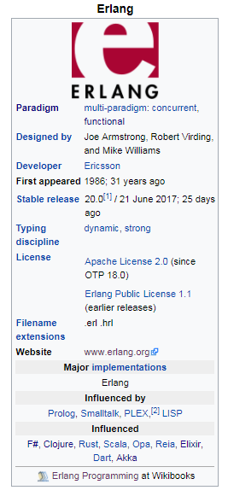
ERLANG

Slide 43
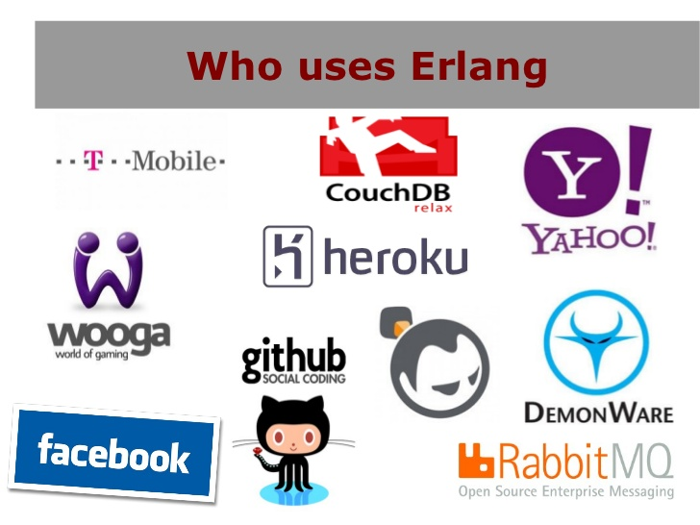
What problems does it solve?
“By understanding who uses Erlang, we can understand the kinds of systems!”

Slide 44
Systems that are basically..
“Massively scalable soft real-time systems with requirements on high availability”
“Some of its uses are in telecoms, banking, e-commerce, computer telephony and instant messaging.” – Erlang site
Concurrent software, high level Concurrency

Slide 45
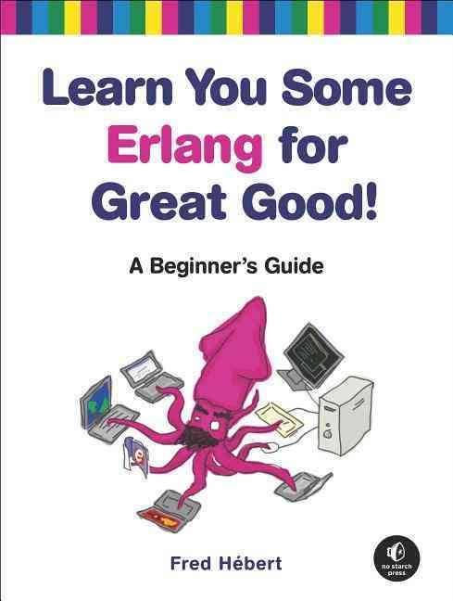
ACTor model
“Erlang uses the actor model, and each actor is a separate process in the virtual machine.” – The book

Slide 46
Actor model
A model. Not a library. Not a technology.
It is a way of thinking about “Computing”
The actor model in computer science is a mathematical model of concurrent computation that treats "actors" as the universal primitives of concurrent computation. - Actor Model, Wikipedia
The actor model originated in 1973.^{[1]} It has been used both as a framework for a theoretical understanding of computation and as the theoretical basis for several practical implementations of concurrent systems. - Actor Model, Wikipedia

Slide 47
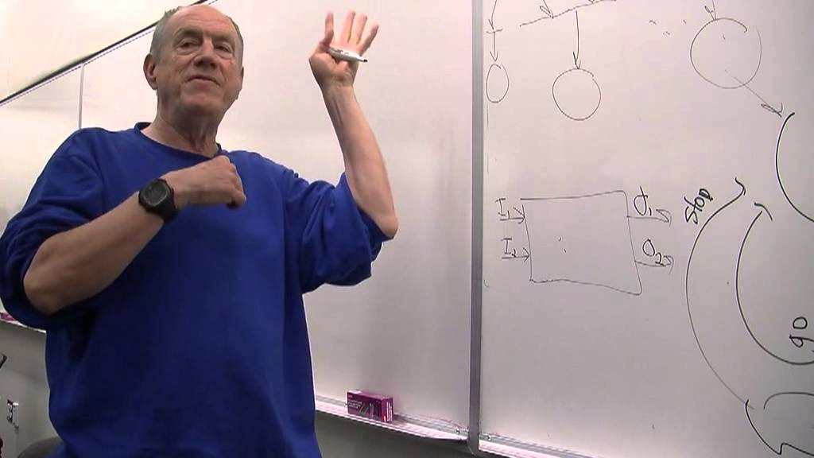
Carl hewitt
“Carl Hewitt explaining the Actor model” - https://www.youtube.com/watch?v=7erJ1DV_Tlo&t=761s

Slide 48
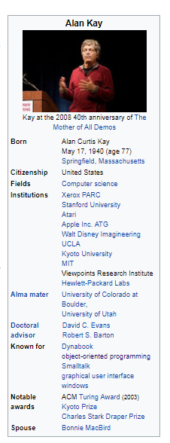
Alan kay
“I made up the term 'object-oriented', and I can tell you I didn't have C++ in mind”
-- Alan Kay, OOPSLA '97

Slide 49
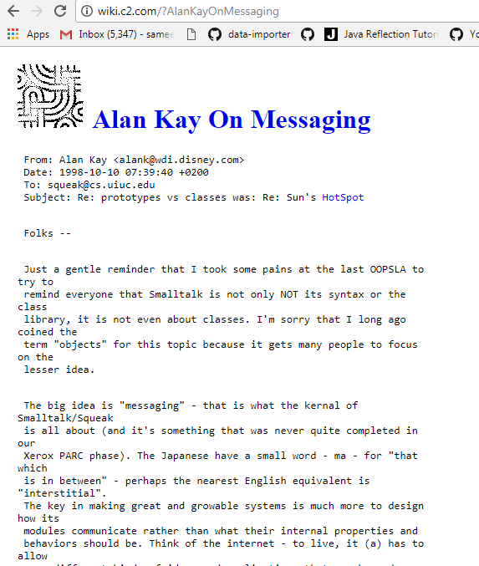
Alan kay on Object orientation
“The big idea is messaging” – Alan Kay

Slide 50
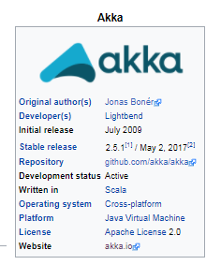
AKKA
“Akka is a free and open-source toolkit and runtime simplifying the construction of concurrent and distributed applications on the JVM. Akka supports multiple programming models for concurrency, but it emphasizes actor-based concurrency, with inspiration drawn from Erlang.” – Akka, Wikipedia
http://akka.io/, http://getakka.net/

Slide 51
Jose valim

Slide 52
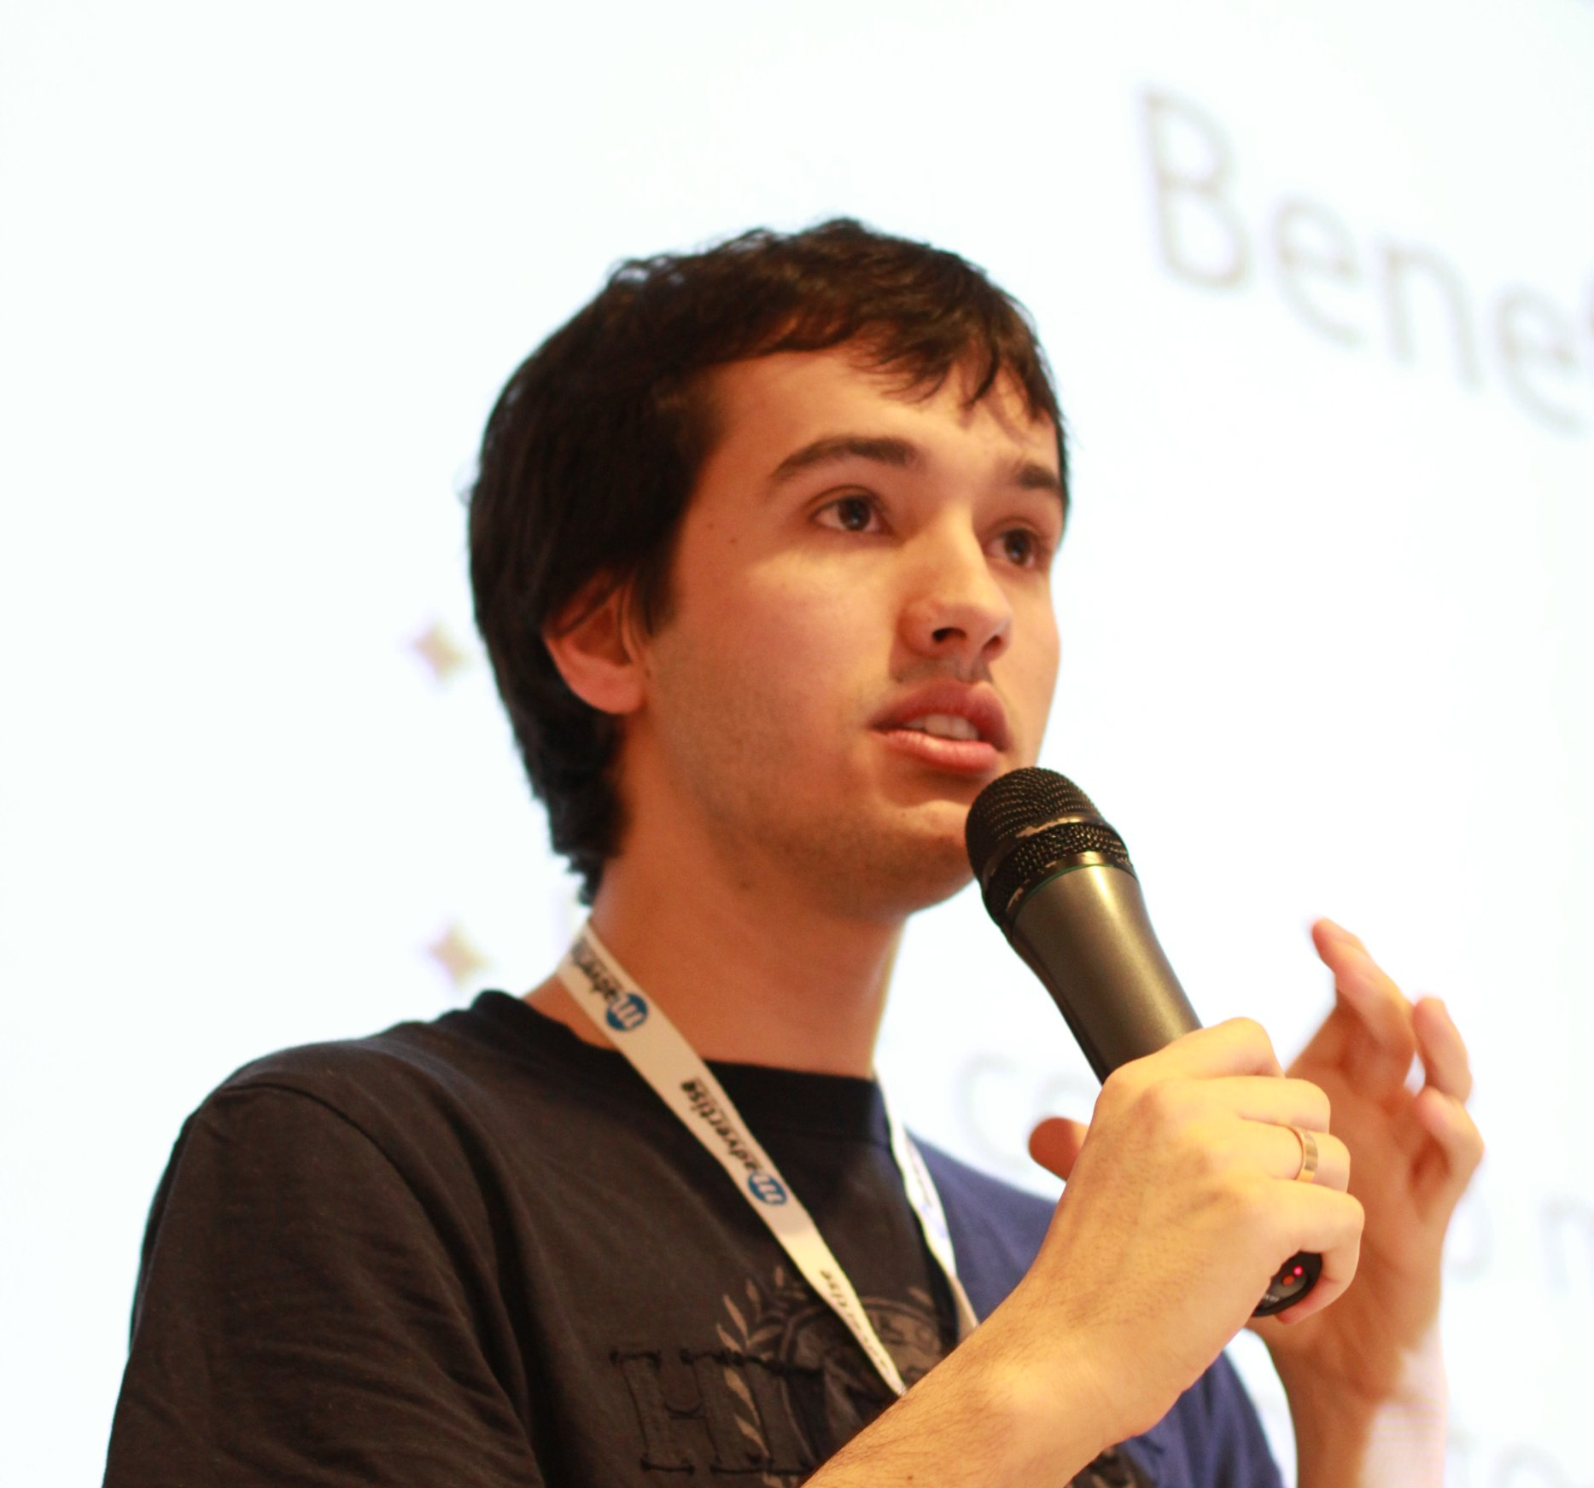
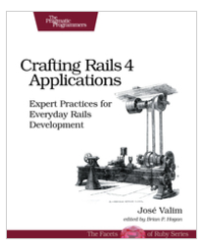
Say hi to jose valim
RUBY ON RAILS CORE CONTRIBUTOR

Slide 53
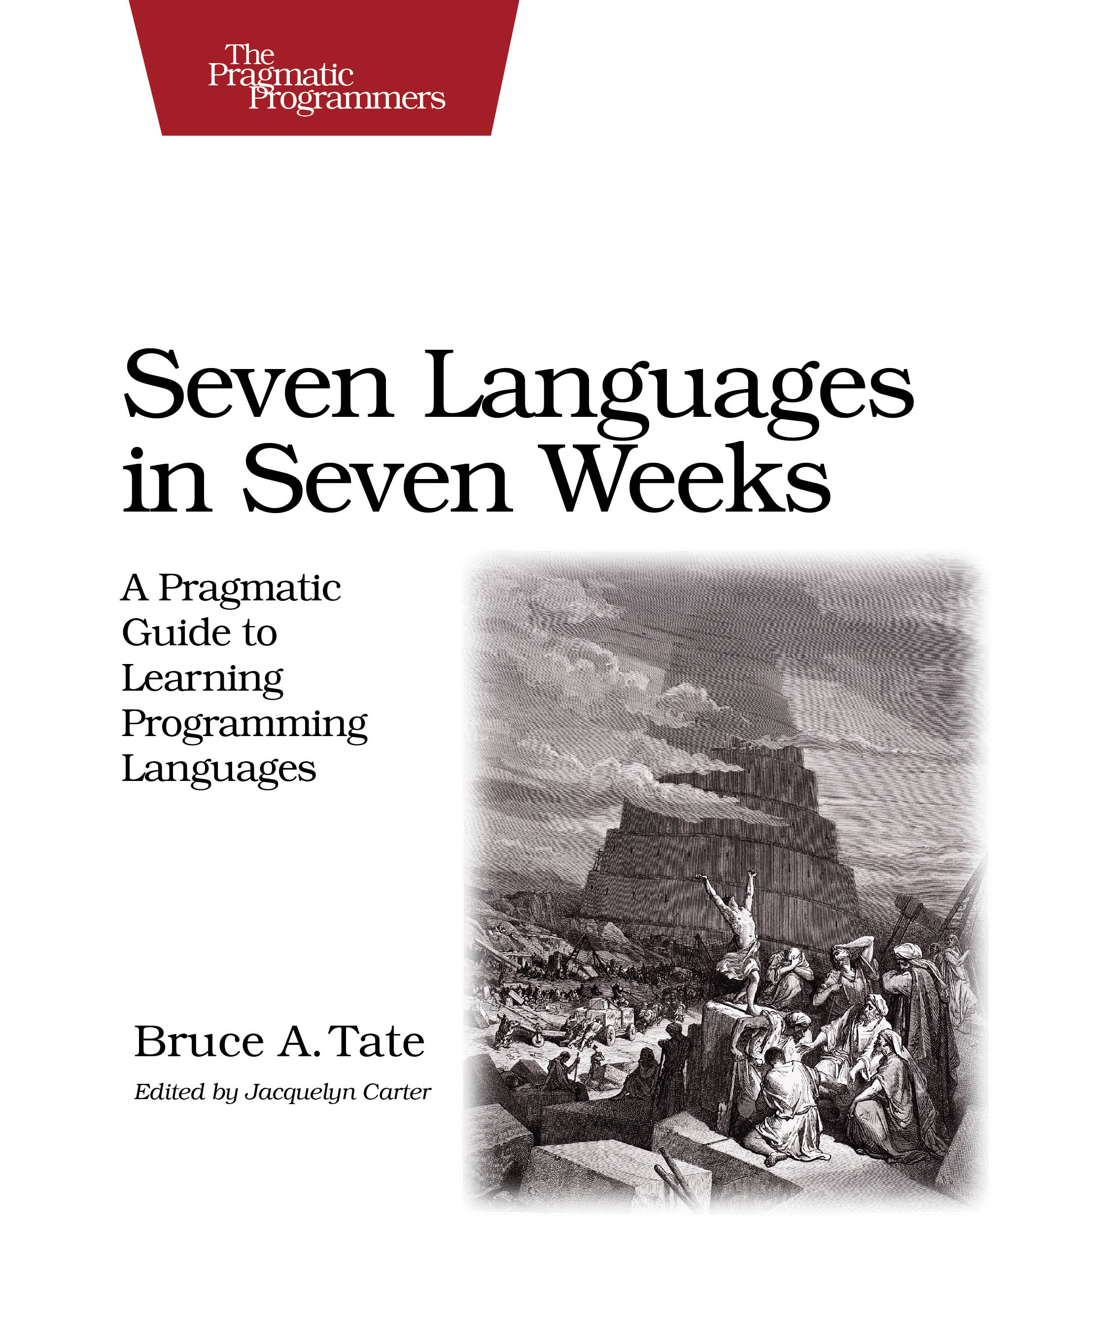
I need “High performant software” - jose

Slide 54
In Love with erlang
He loves the technology!
He loves the concepts!
He chooses to adopt the “Erlang VM” to his toolset.
But after sometime…
Starts thinking hard
I need better tooling.
I need a better syntax.

Slide 55


Slide 56
Elixir
Built on top of the Erlang VM
Modern syntax
Aggregated ideas from various programming languages.
Interoperable with Erlang code.
All benefits from OTP free.
Builds on top of Erlang constructs and provides cleaner abstractions.
Amazing tooling.
Sophisticated ecosystem.
Awesome community.

Slide 57
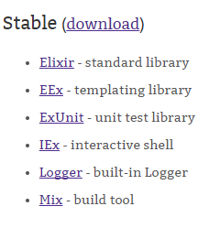
Elixir distribution
Tools – elixir, elixirc, iex
Standard Library
Mix – The comprehensive build system : Best practices, code organization, code generation
ExUnit -

Slide 58
Elixir in action…

Slide 59
Agenda
Distribution
Iex
:observer

Slide 60
ECOSYSTEM

Slide 61
THE POWER OF ELIXIR
Metaprogramming
Utilizing the Erlang VM

Slide 62
CODE CONSTRUCTS
Module
Function
The |> operator
Data – Atoms, Tuples, Lists, Maps, Binaries, Strings, Char lists, Keyword lists
Pattern Matching
‘=‘ does not mean assignment. It means binding.

Slide 63
CODE EXAMPLE

Slide 64
Resources to learn elixir

